Slide 1
AgData Transforming Agriculture Through Efficient Data Collection & Analytics
Daniel Mbeyah

Slide 2
Problem Statement
Inefficient & expensive methods of collecting real-time data from farms
Staff shortage
Lack of a platform that can provide Big Data capabilities from raw data collected from farms for informed decision making
Inadequate feedback on seed products

Slide 3
Solution: AgData
Real time farm data collection using
sensors (Weather/Soil/Farmer Feedback)
Blockchain storage in distributed syst.
Analysis and presentation of Ag-Data on
seed performance to facilitate informed
decision making

Slide 4
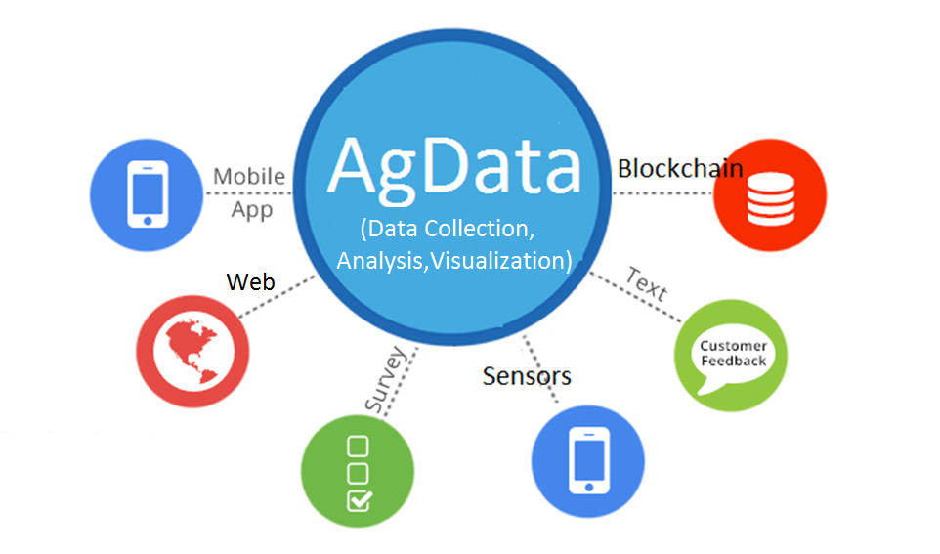
AgData Structure

Slide 5
How It Works
Install Sensor On Farm
Register Farm On AgData
AgData Calls Sensor For Geolocation Using Mac Address
Sensor Pushes Geolocation to AgData
AgData Pushes Data To IOTA & aWhere (Cloud)
…Sensor pushes periodic data to IOTA (Distributed Ledger Blockchain)

Slide 6
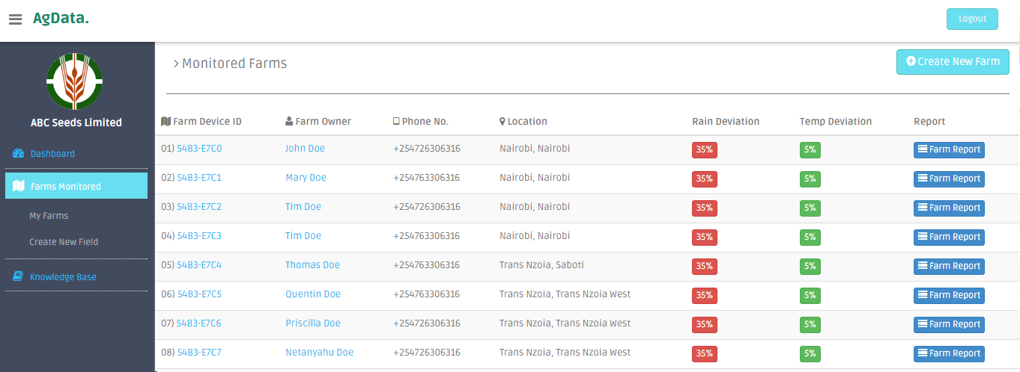
Farms Listing Module

Slide 7
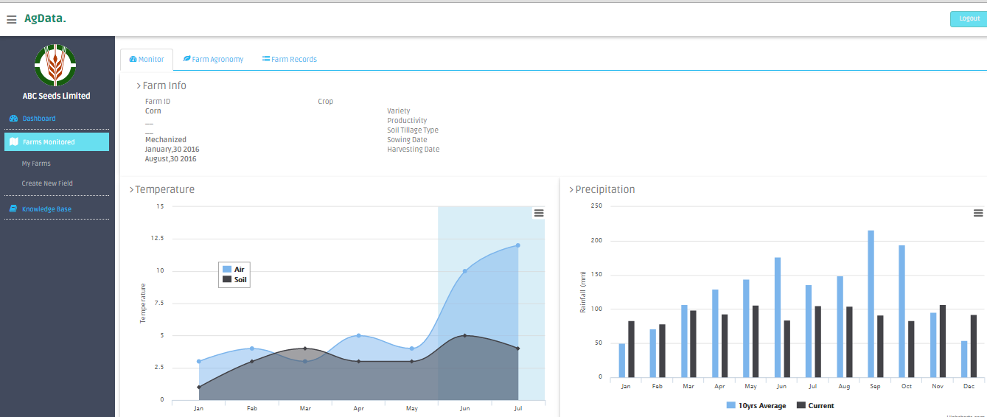
Farm Report Module

Slide 8
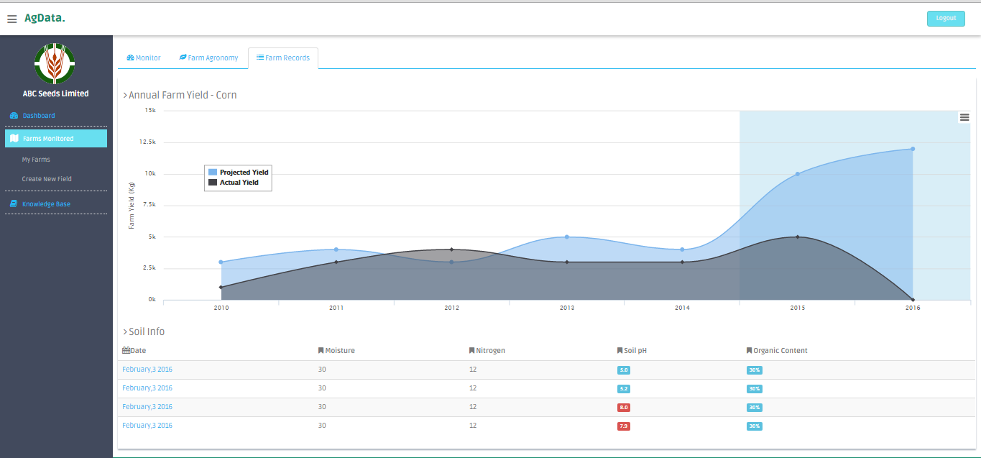
Farm Report Module

Slide 9
Business Model
A) Full Service Model
B) Platform Model
Access To Platform
Sensor Installation
Personnel to Collect Data
Annual/Monthly Subscription Basis, Sell Raw Data (ARIs)
Access to platform
Sensor Installation
Annual/Monthly Subscription Basis, Sell Raw Data (ARIs)

Slide 10
Market
Seed Developers
Seed Marketers And Distributors
Agricultural Research Institutions

Slide 11
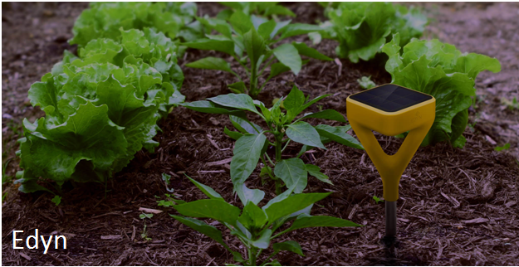
Reality Check: Global
Edyn Garden Sensor
$99.99
Light
Humidity
Temperature
Soil Nutrition
Moisture
API Access,WiFi

Slide 12
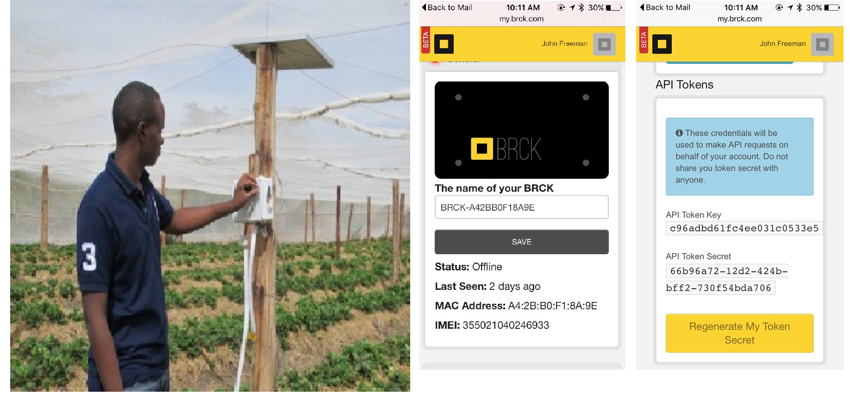
Reality Check: Local (BRCK, Illuminum)

Slide 13
Future
Design And Build AgData’s Sensors

Slide 14
Thank You Get In Touch +254 726 306 316 danmbeyah@gmail.com

